Slide 1



Welcome!
August 2025
Kansas WORK Electronic Visit Verification (EVV) Training

Slide 2

Today’s topics
Overview
Connect & EVV
Employer Worksite Locations
Getting Started with EVV
Time Entry
Shift Exceptions
Interactive Voice Response (IVR)
Activity Codes
Resources / Additional Support
Notes:
Intro : Pamela Jones
Learning & Dev Manager here at Palco
Muted and questions/ chat
Will be provided with guide

Slide 3

Overview

Slide 4



-
MISSION & CORE VALUES
Empowering Independence. Sharpened by experience and amplified by
modern technology, Palco advocates for people to live independent lives.
4
PALCO
Notes:
Mission
Core Values for Palco

Slide 5




COMPANY HIGHLIGHTS
over
1st
25
F/EA in the country
Nationally-recognized thought leaders in self-direction
years of FMS experience
years
18
13
$580M
Women owned and operated
Programs Served
of Support Broker Experience
In total payroll and vendor payments administered
5
Notes:
FMS- Fiscal Management Service
F/EA –Fiscal/Employer Agent

Slide 6

Palco will transition all Kansas WORK participants to the Palco EVV solution on September 7th and AuthentiCare will be turned off at the end of September.
6

Slide 7


Transition Schedule
The dates below highlight the transition schedule for Palco’s EVV Solution!
Date | Milestone
August 14th | Live Webinar Trainings for MCO staff and ILCs
August 19th, 27th, and September 4th | Live Webinar Trainings for WORK Employers and Workers
September 7th | WORK begins using Palco EVV

Slide 8


ELECTRONIC VISIT VERIFICATION (EVV)

Slide 9

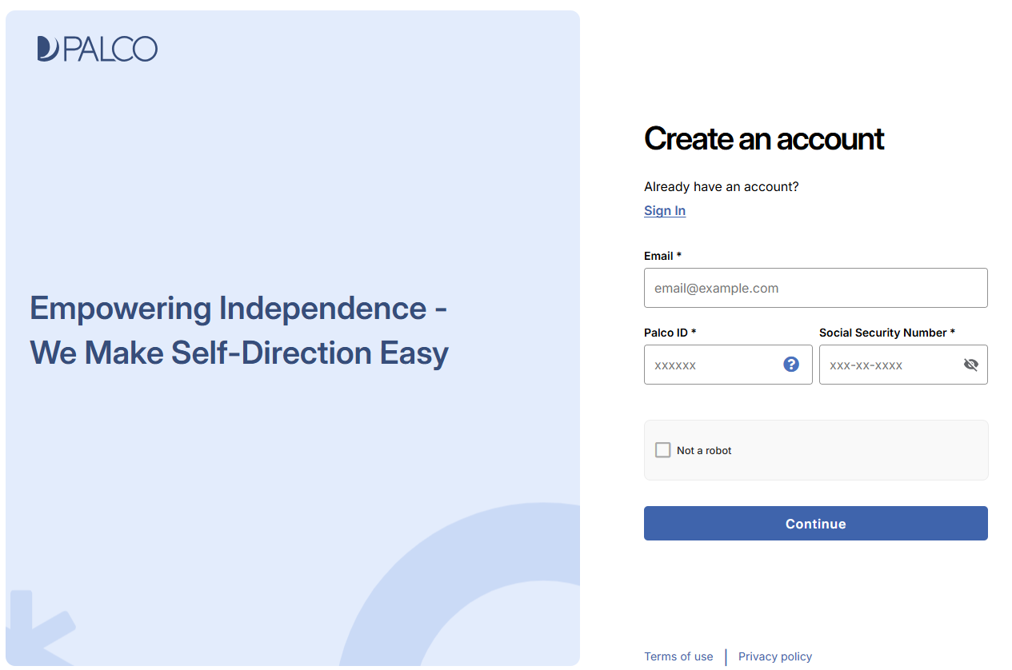
Connect
Connect is Palco’s online timesheet portal for Employers and Workers. Connect provides everything a self-directing Employer or Worker may need, right at their fingertips! Accessible 24/7, some features of Connect include the ability to enter time, integration with Electronic Visit Verification (EVV), the ability to track and monitor spending, to update personal contact information, and access W-2s and paystubs.
Notes:
By now you should

Slide 10

What is EVV?
Electronic Visit Verification (EVV) is a validation of the date, time, location, type of Personal Care or Home Health Care Services being provided, and the individuals providing and receiving services. This information helps to ensure that the Participants receive the expected care. EVV is a federal mandate included in section 12006 of the 21st Century Cures Act.
Palco has created a web-based, user-friendly platform to provide our Participants with tools to remain EVV compliant. The two options for using EVV with Palco are:
  Connect
  Telephony/IVR (Interactive Voice Recognition) via a touchtone phone.
Enrollment Reminder
Electronic Visit Verification (EVV) is a Federal Mandate! Compliance is required.
Notes:
Date time location type of service and who
Talophony

Slide 11

EMPLOYER WORKSITE LOCATIONS

Slide 12
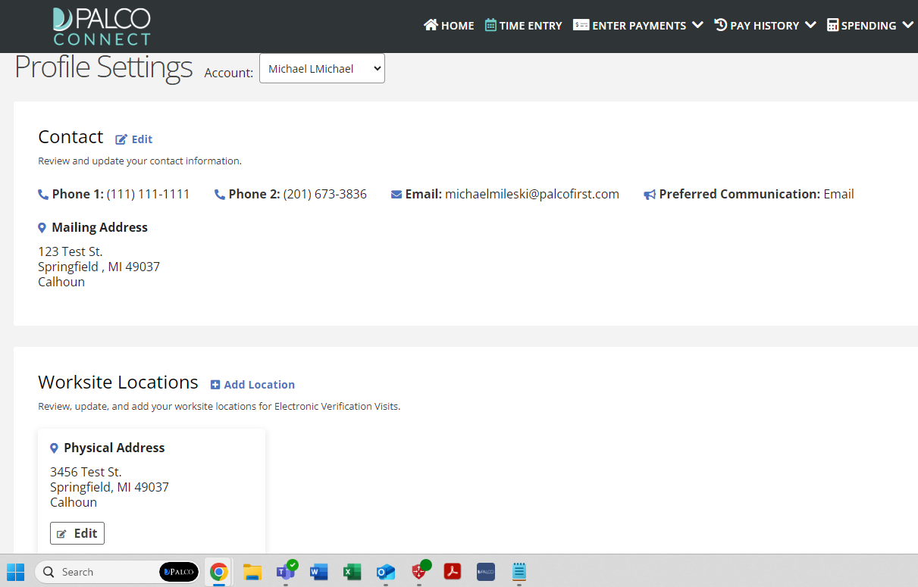
Employer worksite locations
One of the most important parts of EVV is location reporting. The system records the worker’s geocoordinates when they clock in and out. This is done to verify that the worker is where they should be when providing services.
The employer needs to add these worksite locations to their profile. The area surrounding a worksite location is a geofence. If a worker is reporting time shifts outside of the geofence area, it can be a cause for concern.
Please add all locations to the Profile Settings Page
where either: The employer may receive services or
the worker may provide services.
Step 1
Go to the Profile Settings Page and Click Add Location
It is in the Worksite Locations section, which is below the Contact section.

Slide 13
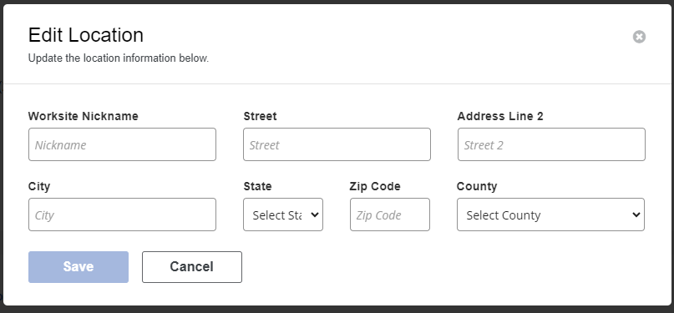
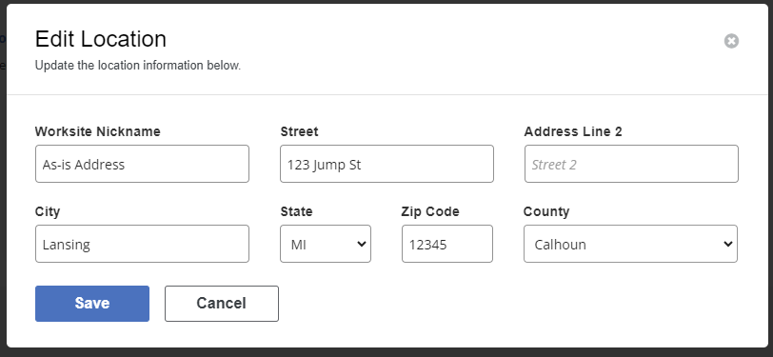
Employer worksite locations
Step 2.
Input the Location Information
When typing the street address, several options may appear. If you see the correct one, you can click it, and the remaining fields will autofill.
Step 3.
Verify Information is Correct, then click Save
The system will make sure the address is valid. If it is not recognized, you will be alerted.

Slide 14
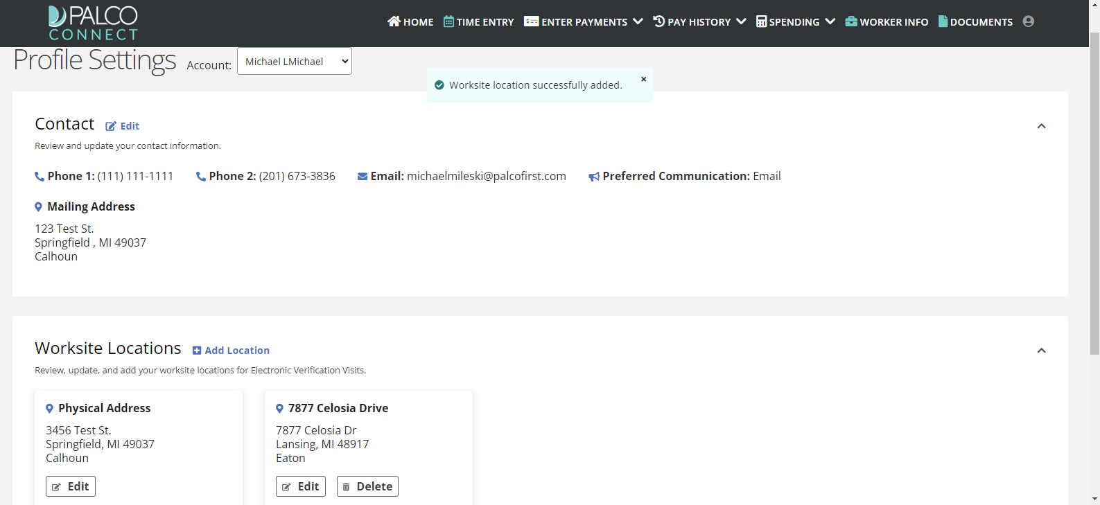
Employer worksite locations
Step 4.
Make Sure The New Location Appears
If the save was successful, you will see “Worksite location successfully added” pop up. You will also see the address under Worksite Locations.
Step 5.
To Make Changes to Existing Locations, Use Edit and Delete
It’s easy to make changes to a saved worksite location. Simply click Edit under the location you wish to change. If you will no longer be receiving services at a saved address, you can use the Delete button to remove it from your profile.

Slide 15
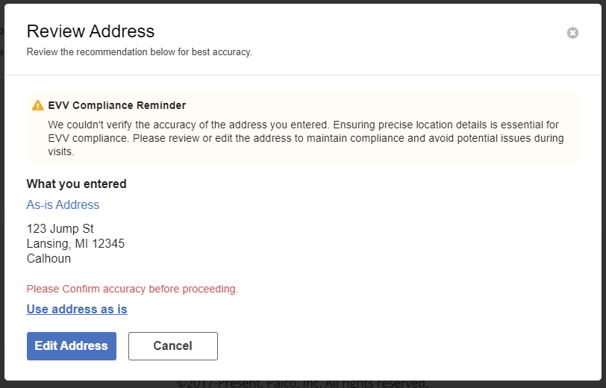
Employer worksite locations
Step 1.
Review the Address for Accuracy
Double-check the spelling of each line. Make sure the house number and ZIP code are also correct.
Step 2.
Decide to Use As-Is or Edit Address
If the address is correct, you can choose to “Use address as-is.” If a correction is needed, choose Edit Address to make changes.

Slide 16

GETTING WORKERS STARTED WITH EVV

Slide 17
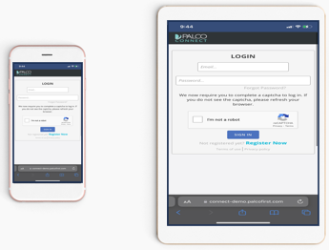

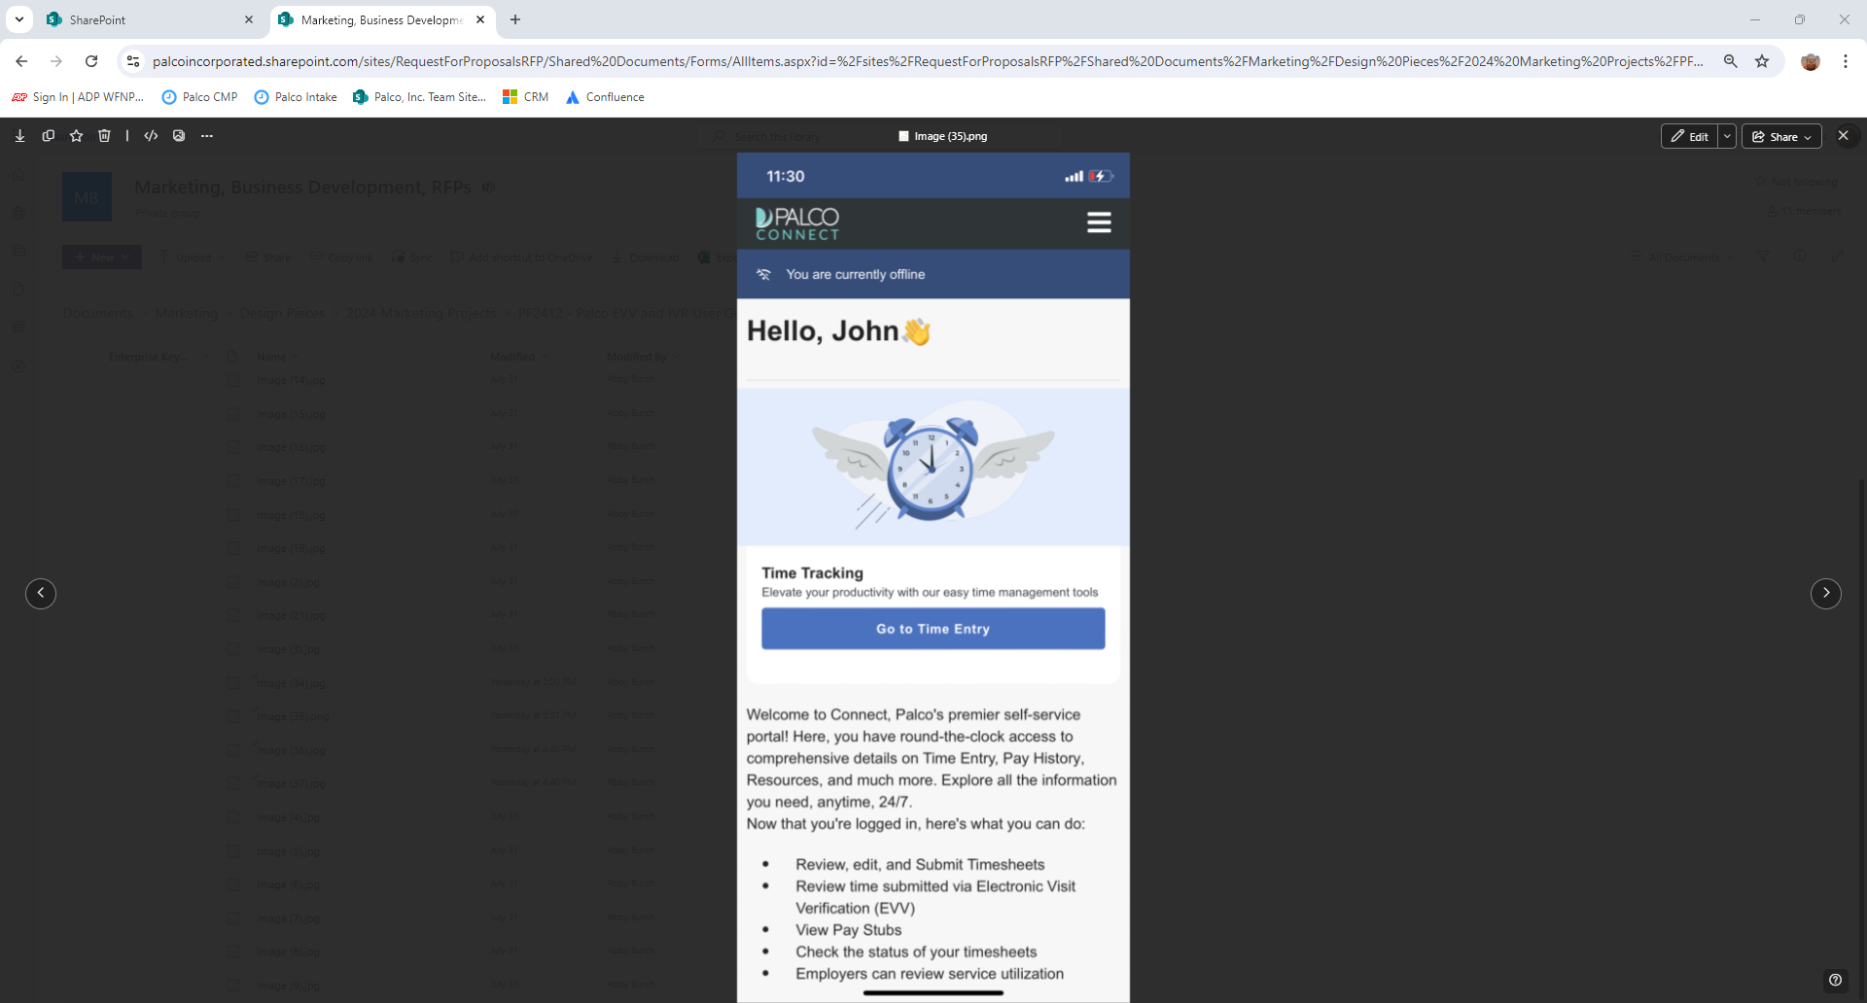
Getting Started
To submit time to Palco, you will need a mobile device that can connect to the Internet, such as a phone or tablet OR YOU CAN INSTALL THE APPLICATION ON YOUR LAPTOP OR DESKTOP COMPUTER USING A WEB BROWSER. Follow these steps to access Palco’s EVV application.
Step 1. Open the browser on your internet-connected device
You can use a phone or tablet. Depending on your device, your browser may be called Safari, Chrome, or simply Internet.
Step 2. Go to connect.palcofirst.com
Step 3. Sign in to Connect
If you do not already have a Connect account, you will need to create one. Use the Register Now button to create an account. Come back to this step once that is done.

Slide 18
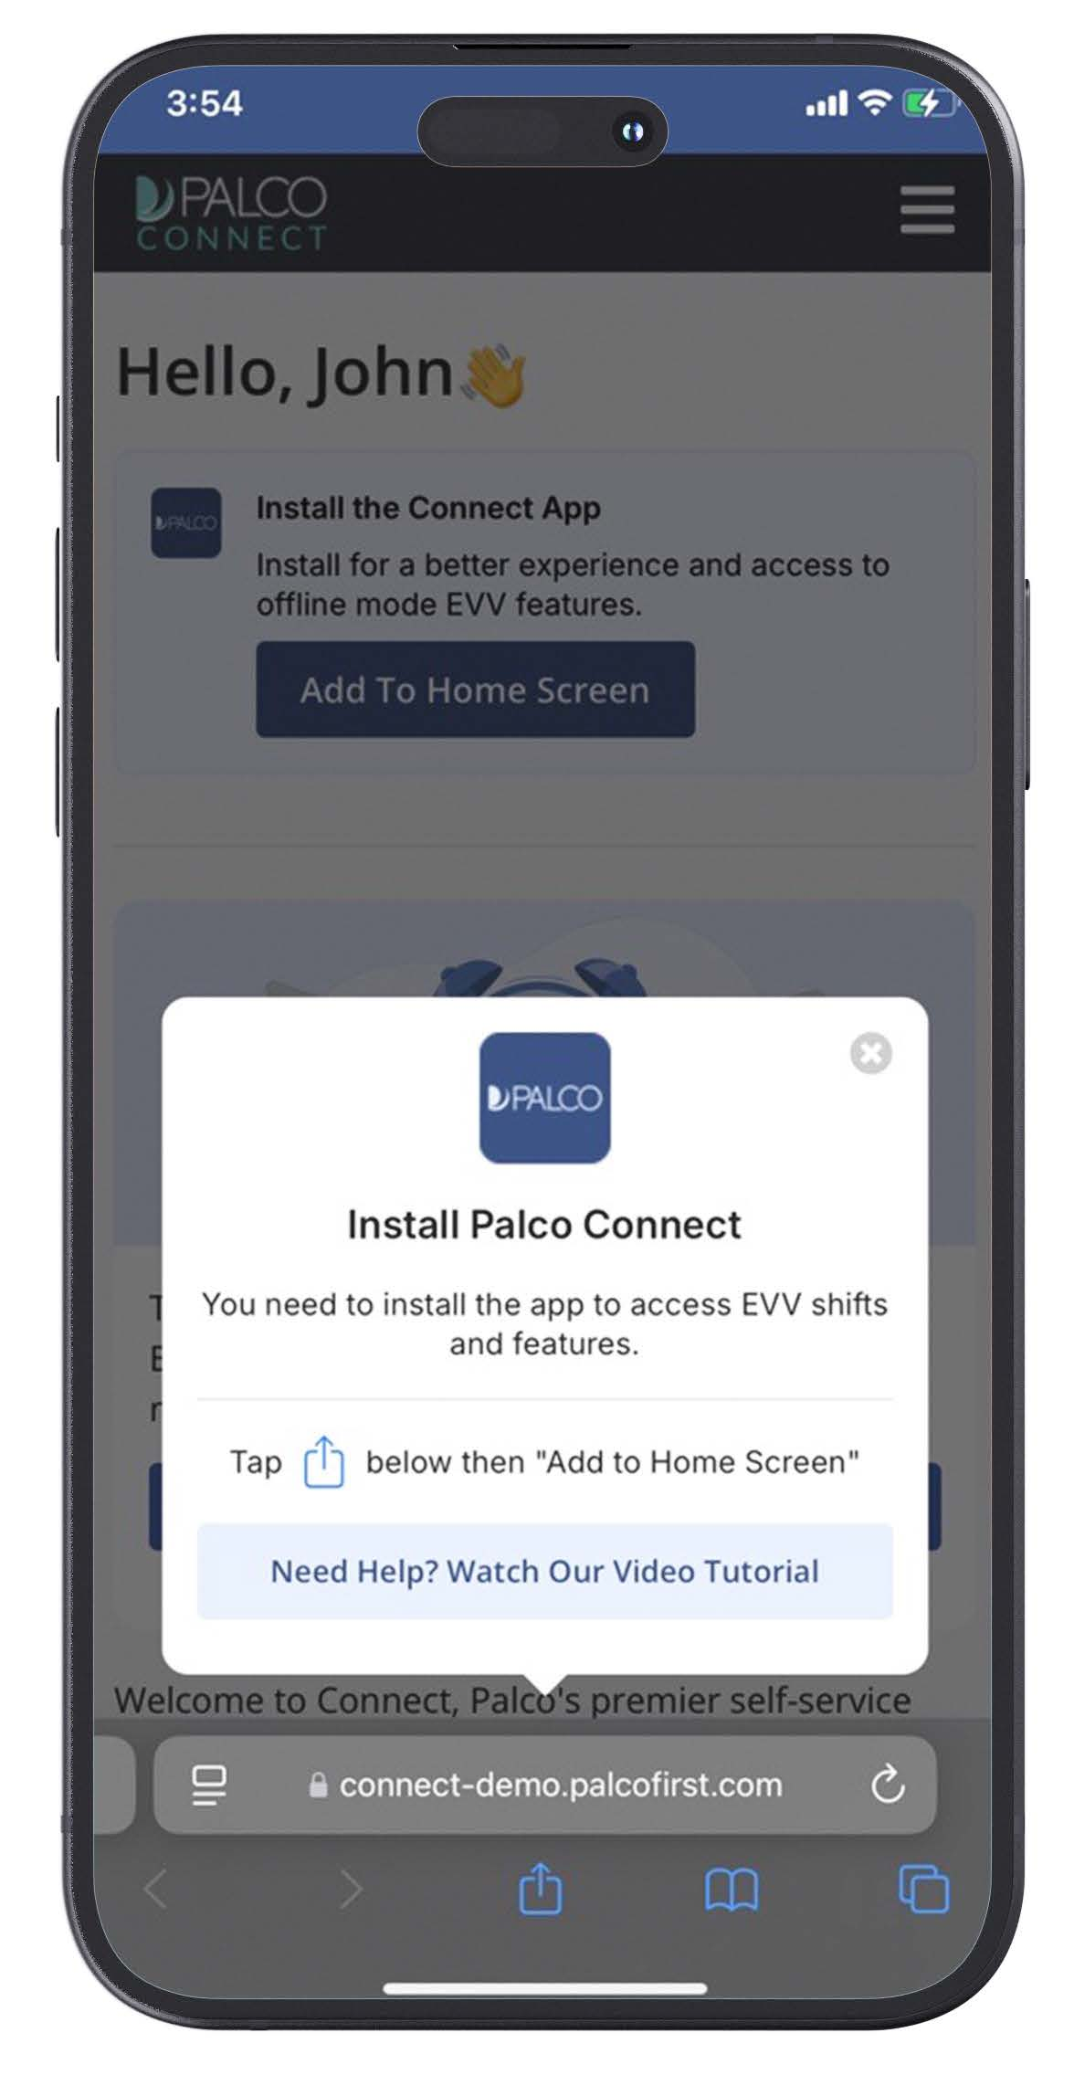

Getting Started Continued
Step 4. Click the blue “Add to Home Screen” button
On the Connect home screen, click the blue button that says
“Add to Home Screen”
Step 5. Tap the icon.
Following the on-screen instructions, tap the icon. Then, tap “Add to Home Screen” within the on-screen menu.
Notes:
DEMO (LEAVE BEHIND ONLY)

Slide 19
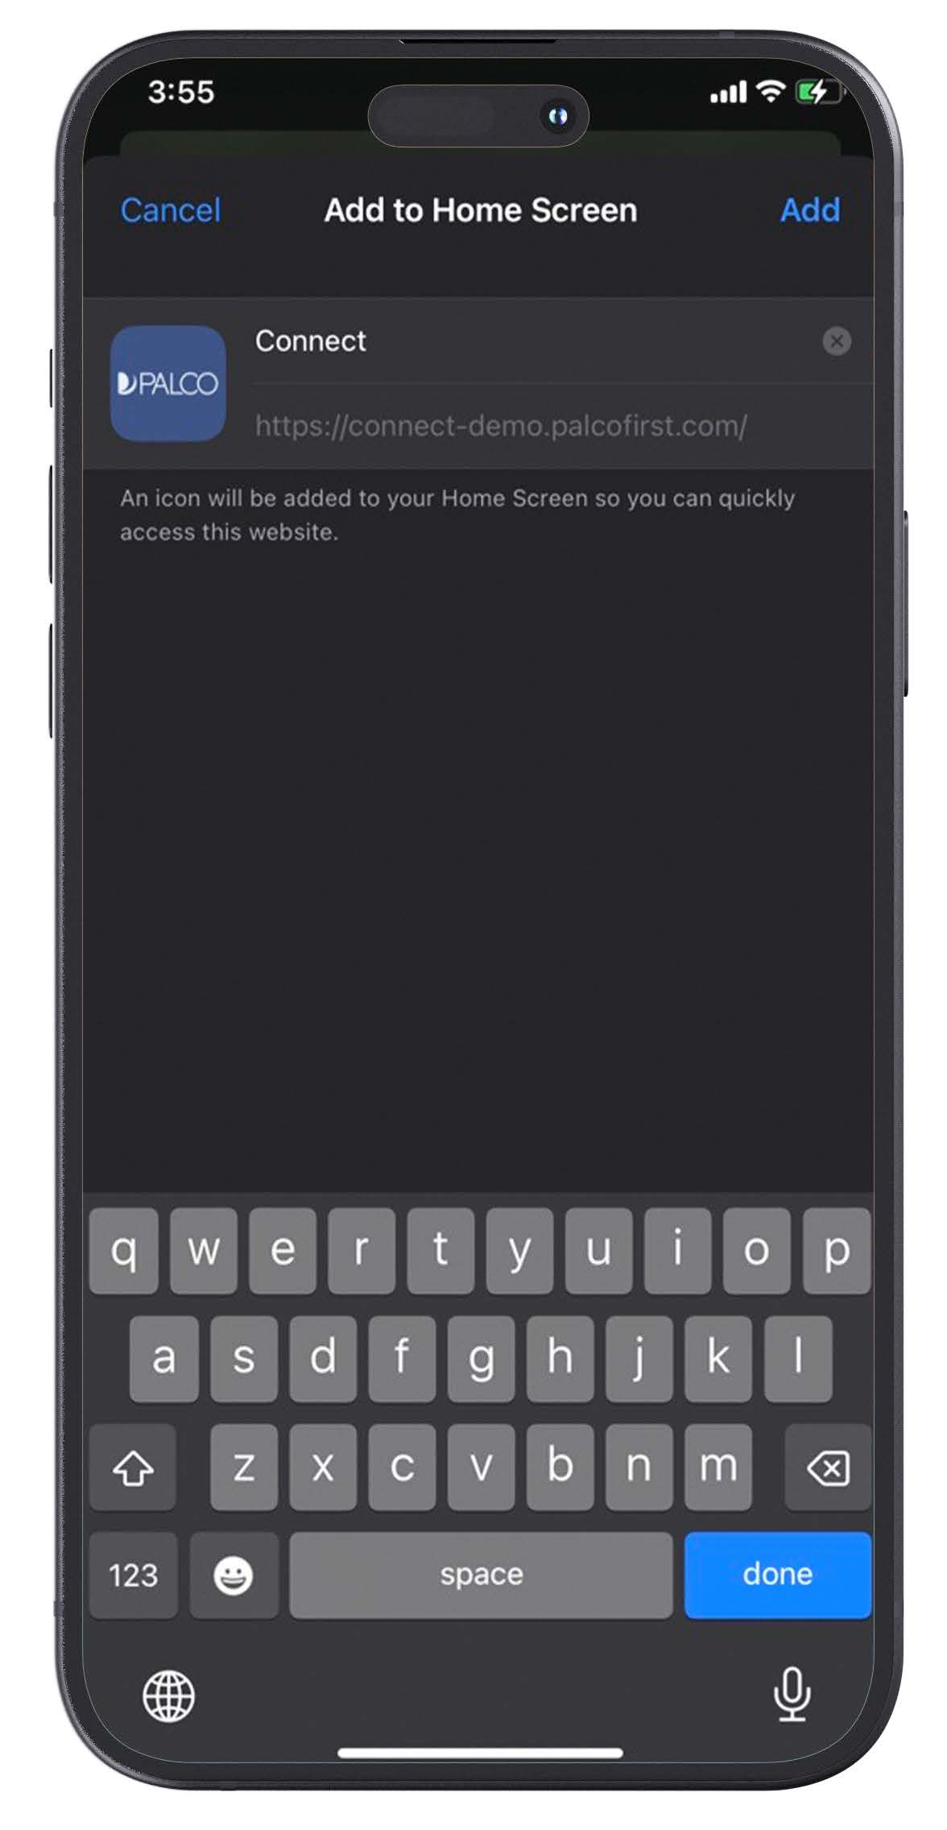
Getting Started Continued
Step 6. Review and Confirm
By default, the Palco application shortcut will be added to your device with the name Connect. You can choose to change this name, or leave it as is. Then, click Add.
Notes:
DEMO (LEAVE BEHIND ONLY)

Slide 20
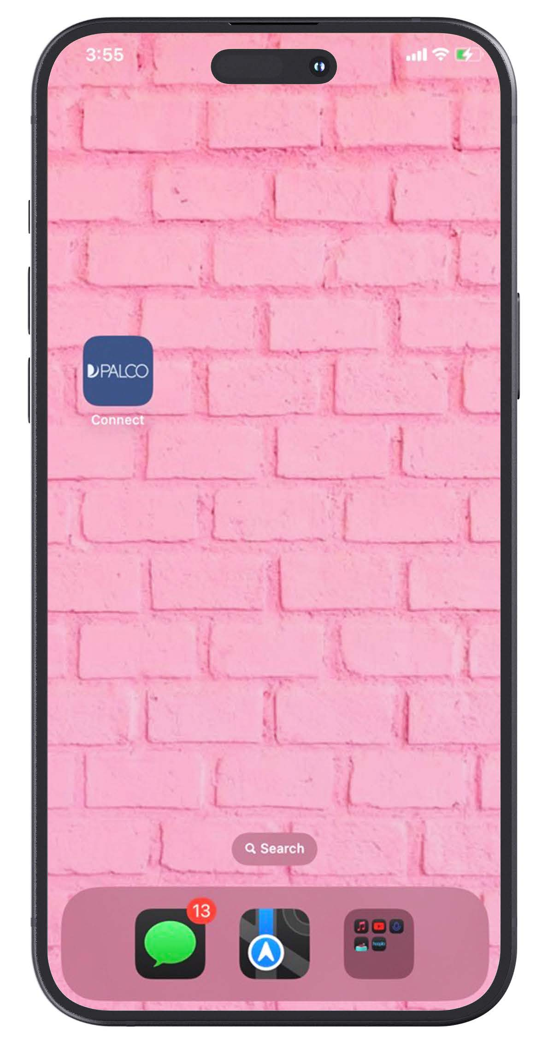
Getting Started Continued
Step 7. Begin using the Application
Go to the home screen of your device. Then, tap the new Palco EVV app icon to start using it.
Note: When you open the app for the first time, you may be asked to log in to Connect again.
Notes:
DEMO (LEAVE BEHIND ONLY)

Slide 21
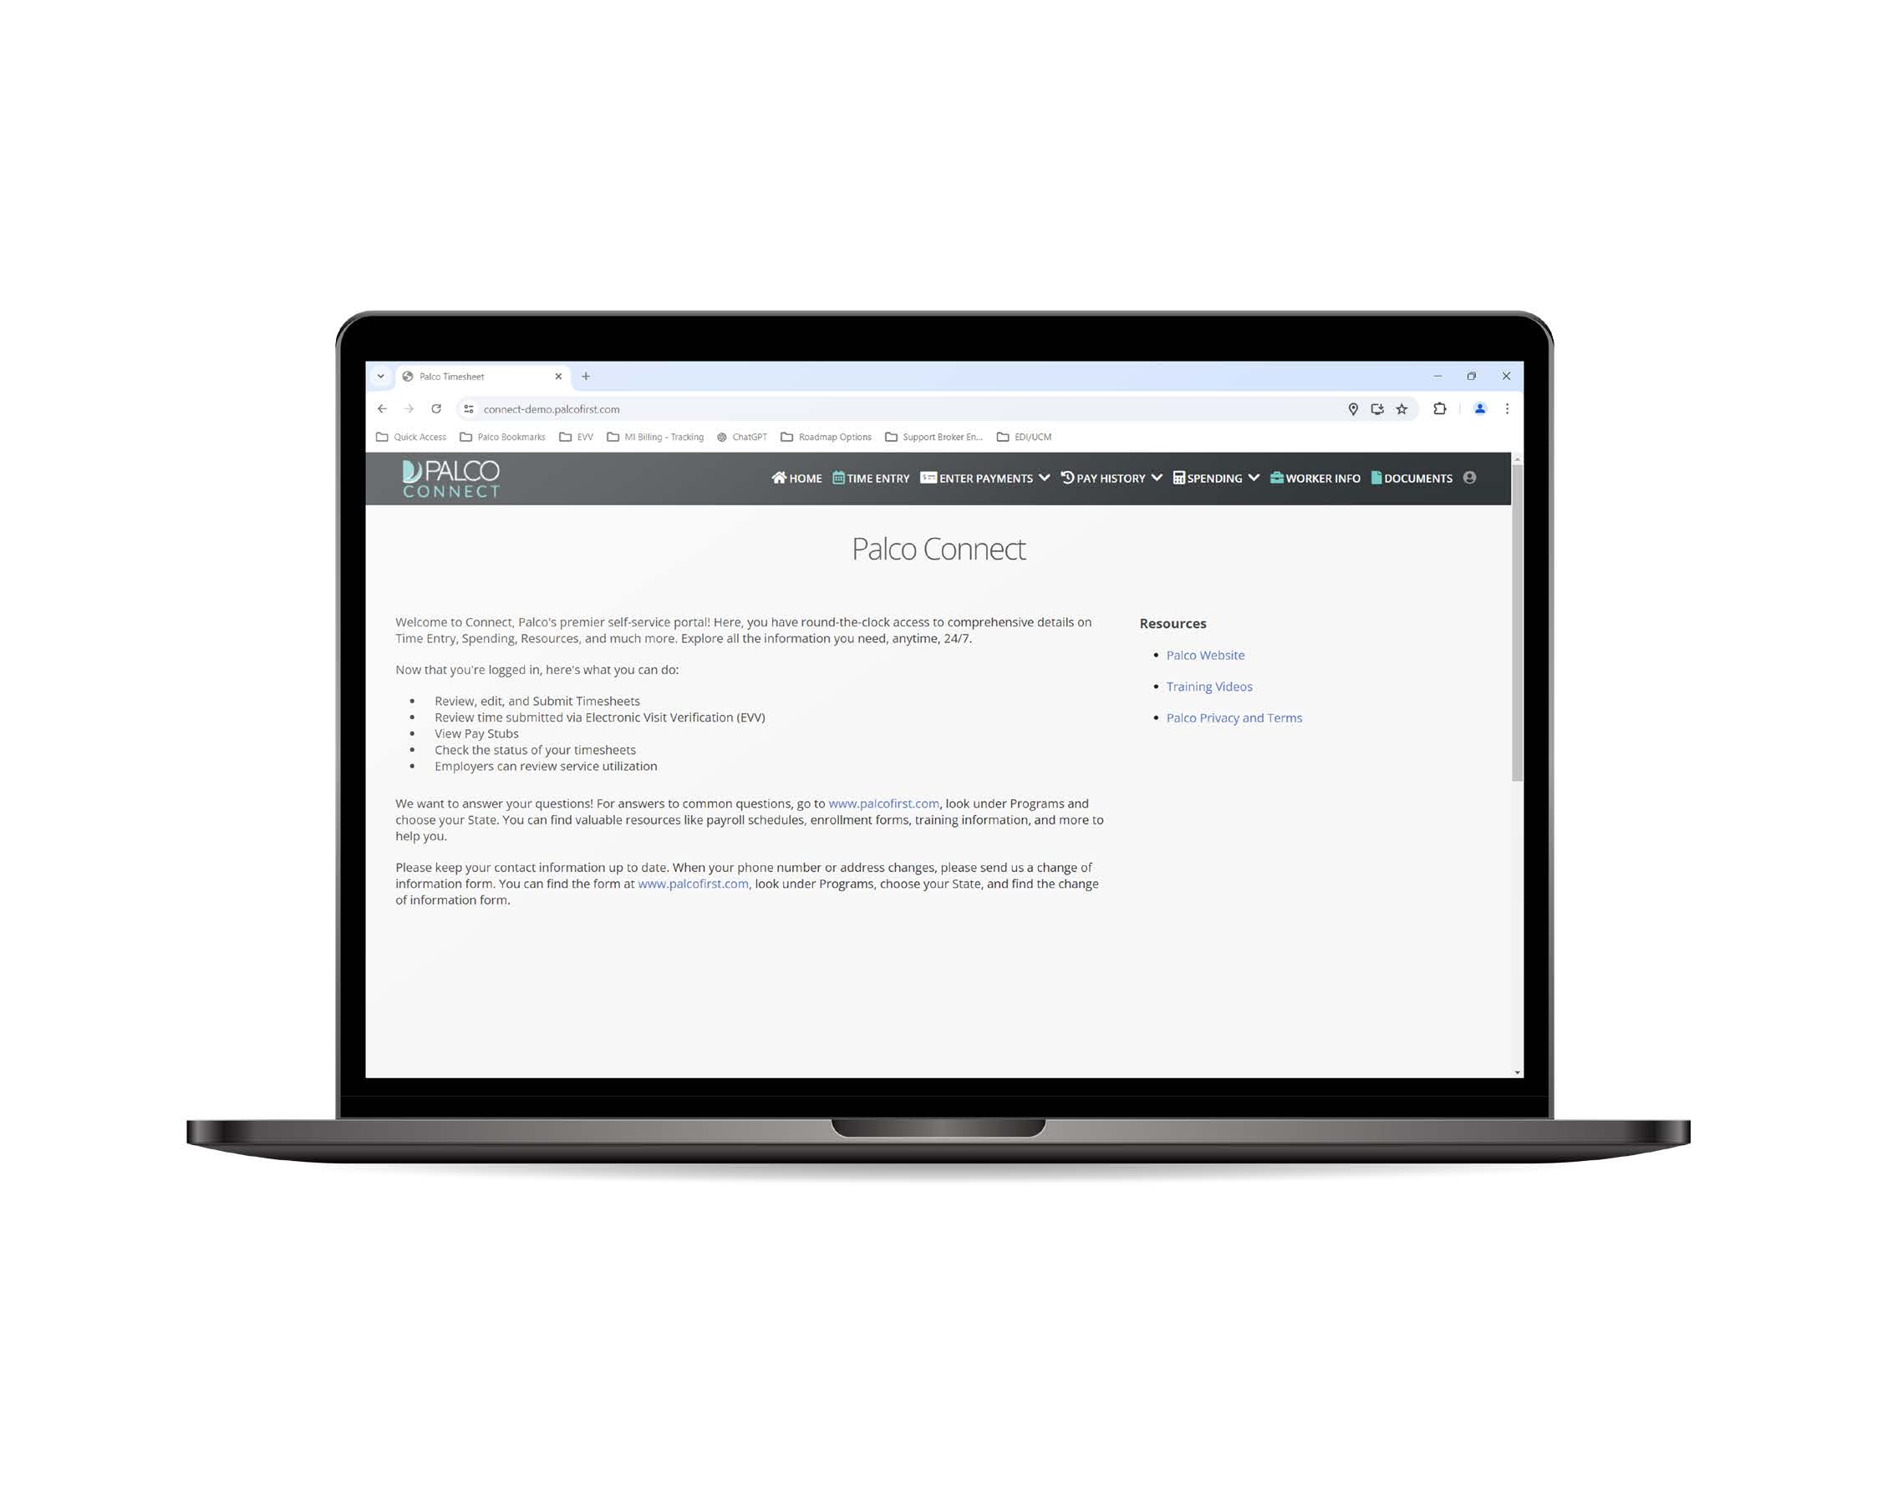
Getting Started
Follow these steps to install Palco’s EVV application on a laptop or desktop computer using a web browser
Step 1. Open the browser on your internet-connected device
You can use a laptop or desktop.
Step 2. Go to connect.palcofirst.com
Step 3. Sign in to Connect
If you do not already have a Connect account, you will need to create one. Use the Register Now button to create an account. Come back to this step once that is done.

Slide 22
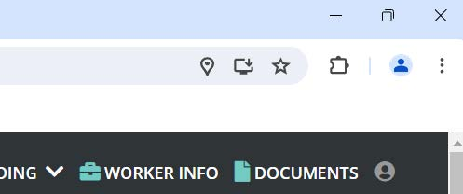
Getting Started Continued
Step 4. Click the install Icon
On the right side of the address bar will be an icon.
Hovering over it says “Install Palco Connect.”
Click this icon to continue.
Notes:
DEMO (LEAVE BEHIND ONLY)

Slide 23
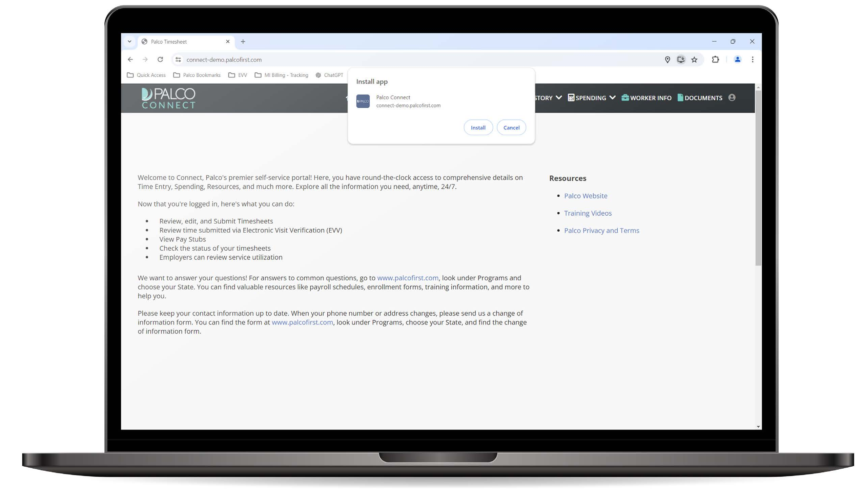
Getting Started Continued
Step 5. Select “Install in the popup window.
Note: Depending on the web browser you are using, your screen may look slightly different than what is shown.
Notes:
DEMO (LEAVE BEHIND ONLY)

Slide 24

TIME ENTRY

Slide 25
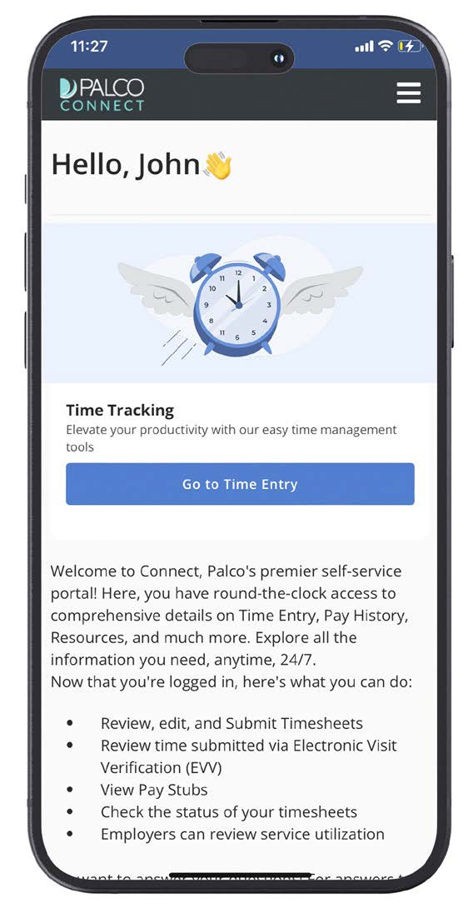
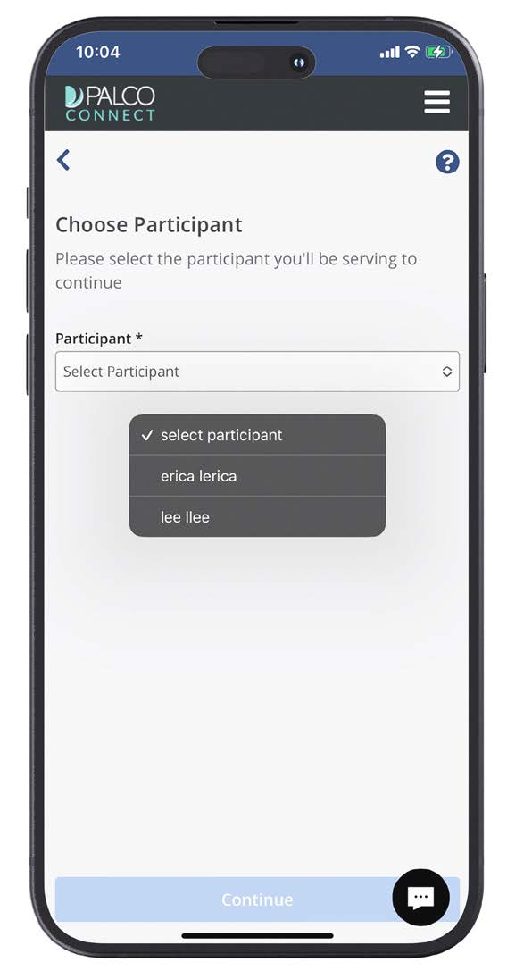
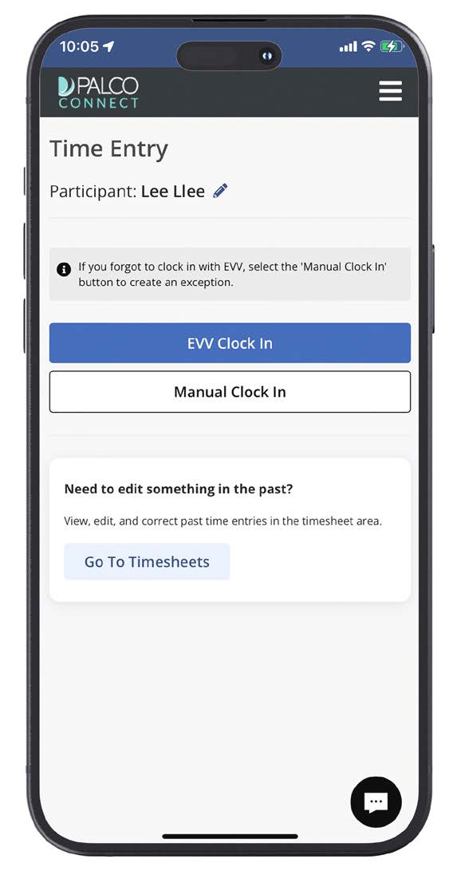
Worker clock in
In this section, we will go over how to start an EVV-compliant time entry. Once logged into Connect, follow these steps.
Step 1. Click on Go to Time Entry Step 2. Select a Participant Step 3. Choose EVV Clock In
This blue button is on the home screen.
You will only need to select a Participant if you work for more than one.

Slide 26
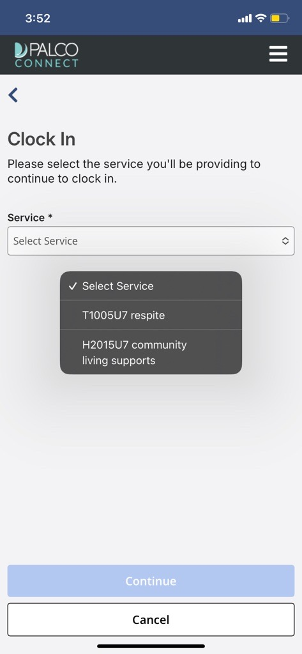
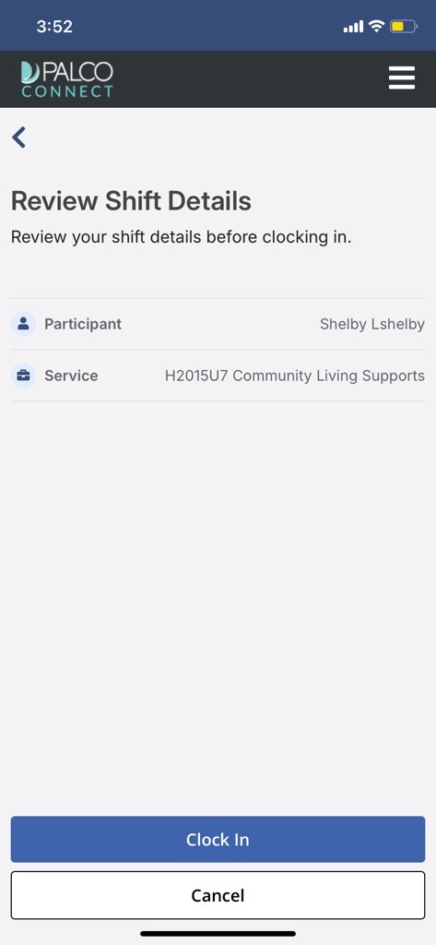
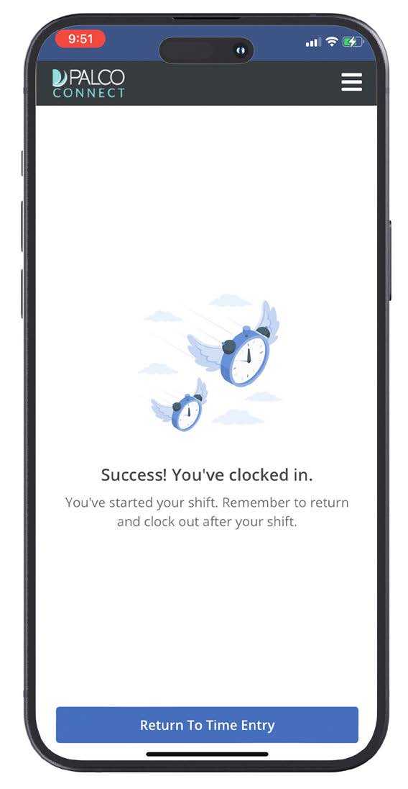
Worker clock in
Step 4. Select a Service to Provide Step 5. Review Shift Details Step 6. Clock In for the Shift
Service code options will be in the drop-down menu.
Double-check that everything is right before submitting.
You are now on the clock for this shift.

Slide 27
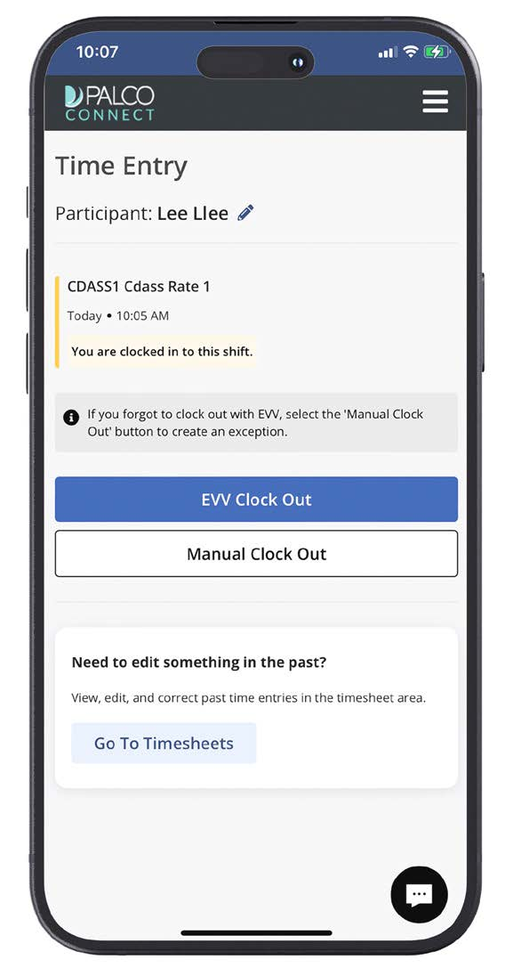
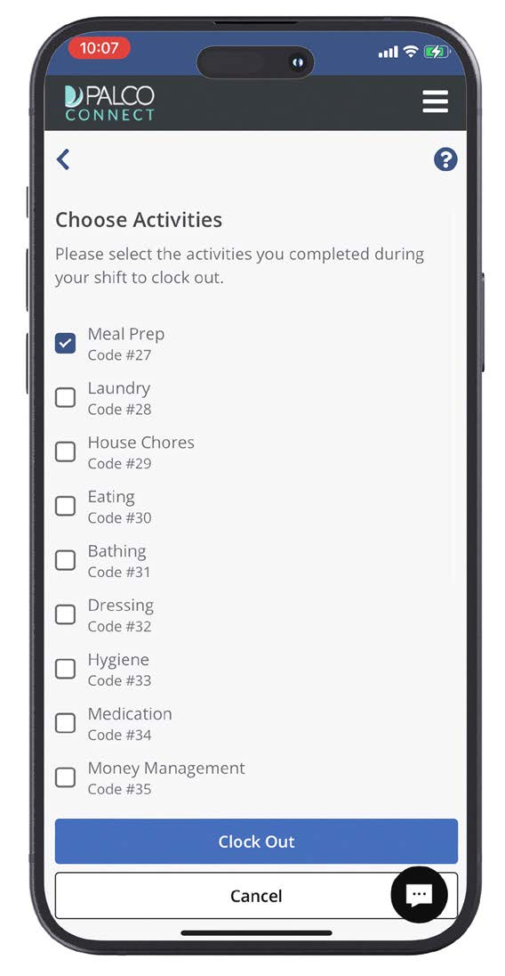
Worker clock OUT
The Clock Out process is very similar to clocking in. Please, do not clock out until you are finished working the shift.
Step 1. Click on Go to Time Entry Step 2. Choose EVV Clock Out Step 3. Select Activities
You will see you are currently clocked in for this shift above the blue EVV Clock Out button.
This blue button is on the home screen.
Use the check boxes to select all activities that were performed during the shift.

Slide 28
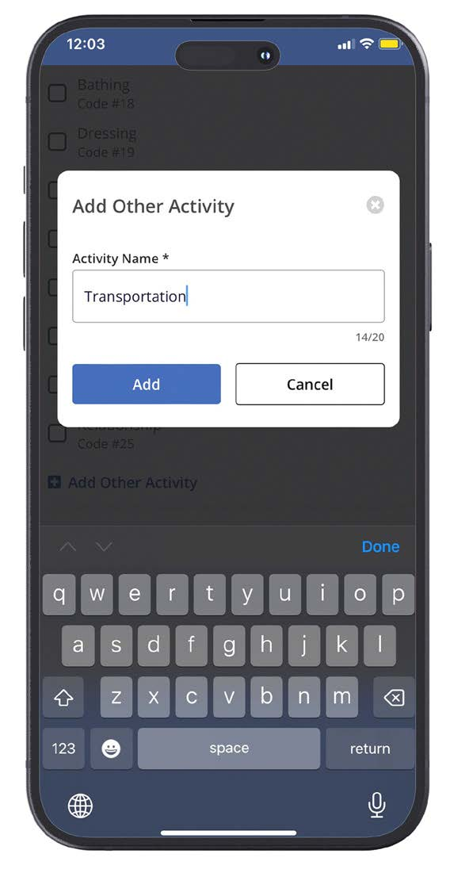
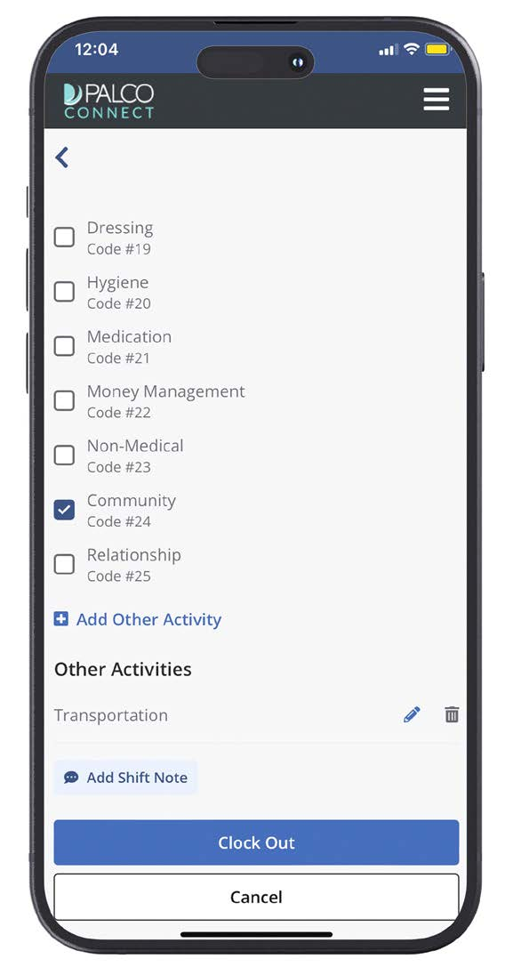
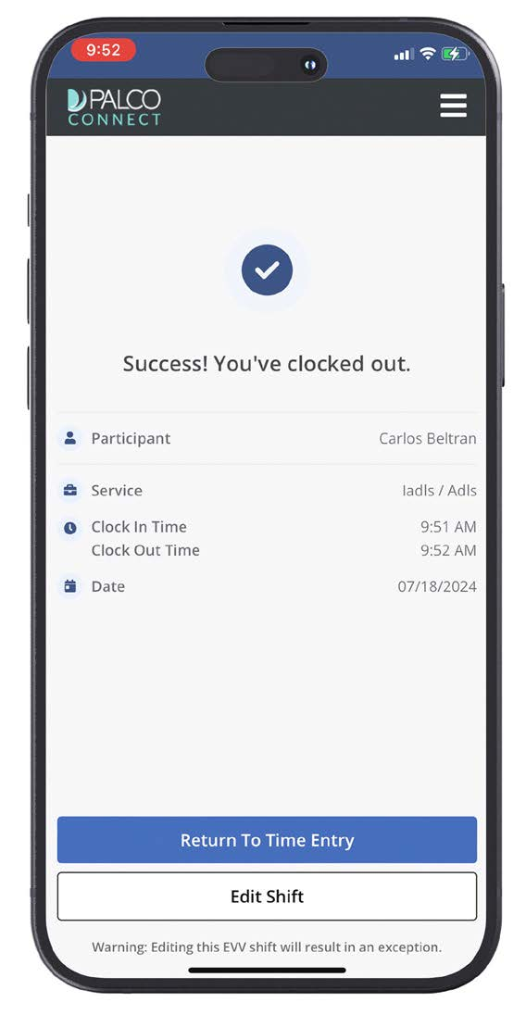
Worker clock OUT
Step 4. Add Manual Activities Step 5. Review Shift Details and Clock Out Step 6. Review Confirmation
If needed, you can manually add an activity.
Double-check all details before tapping Clock Out.
A confirmation screen will show that you were successfully clocked out.

Slide 29
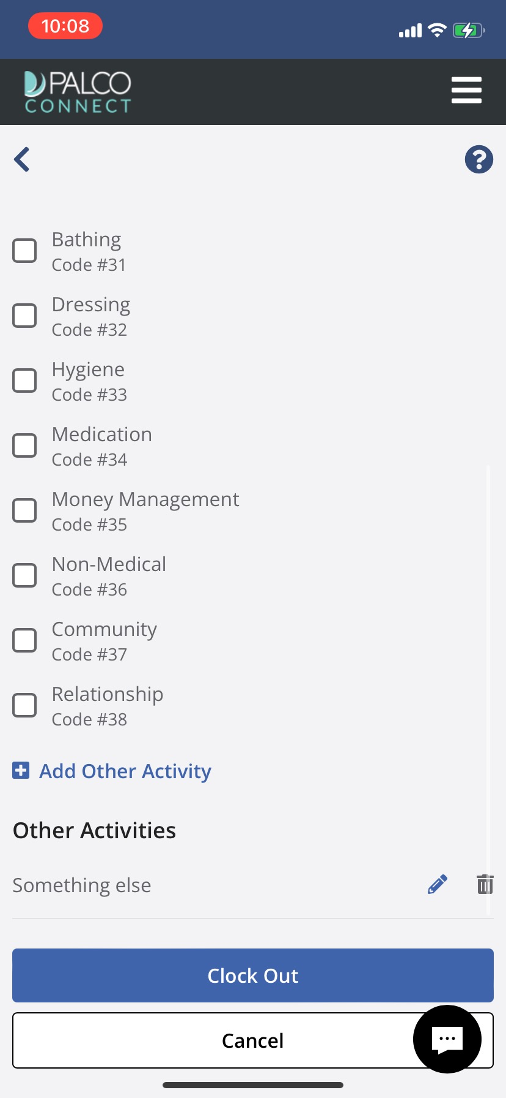


helpful tip
If your program requires an activity, you won’t be able to clock out without selecting one.
Notes:
No activity codes for IDDW

Slide 30
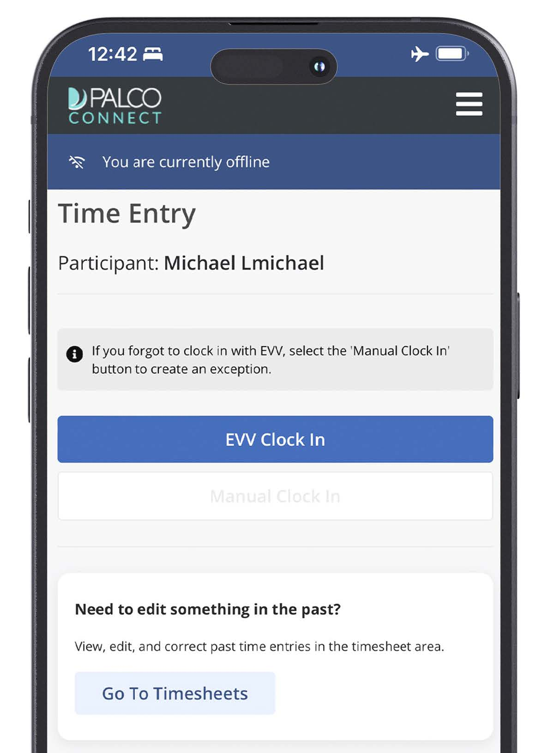
Offline mode
If you are without internet access, you can still clock In and out for shifts. You will follow all the same steps as before. The difference is that you will be in offline mode. Once your internet service is restored, your offline shift data will be synced automatically
You will know you are offline when you see the blue banner near the top of the screen.
When offline, your menu options will be limited. For full use of the Palco EVV app, connect to the internet.
When offline, you will not be able to manually clock in. You can only record an EVV shift when you are offline.

Slide 31

SHIFT EXCEPTIONS

Slide 32
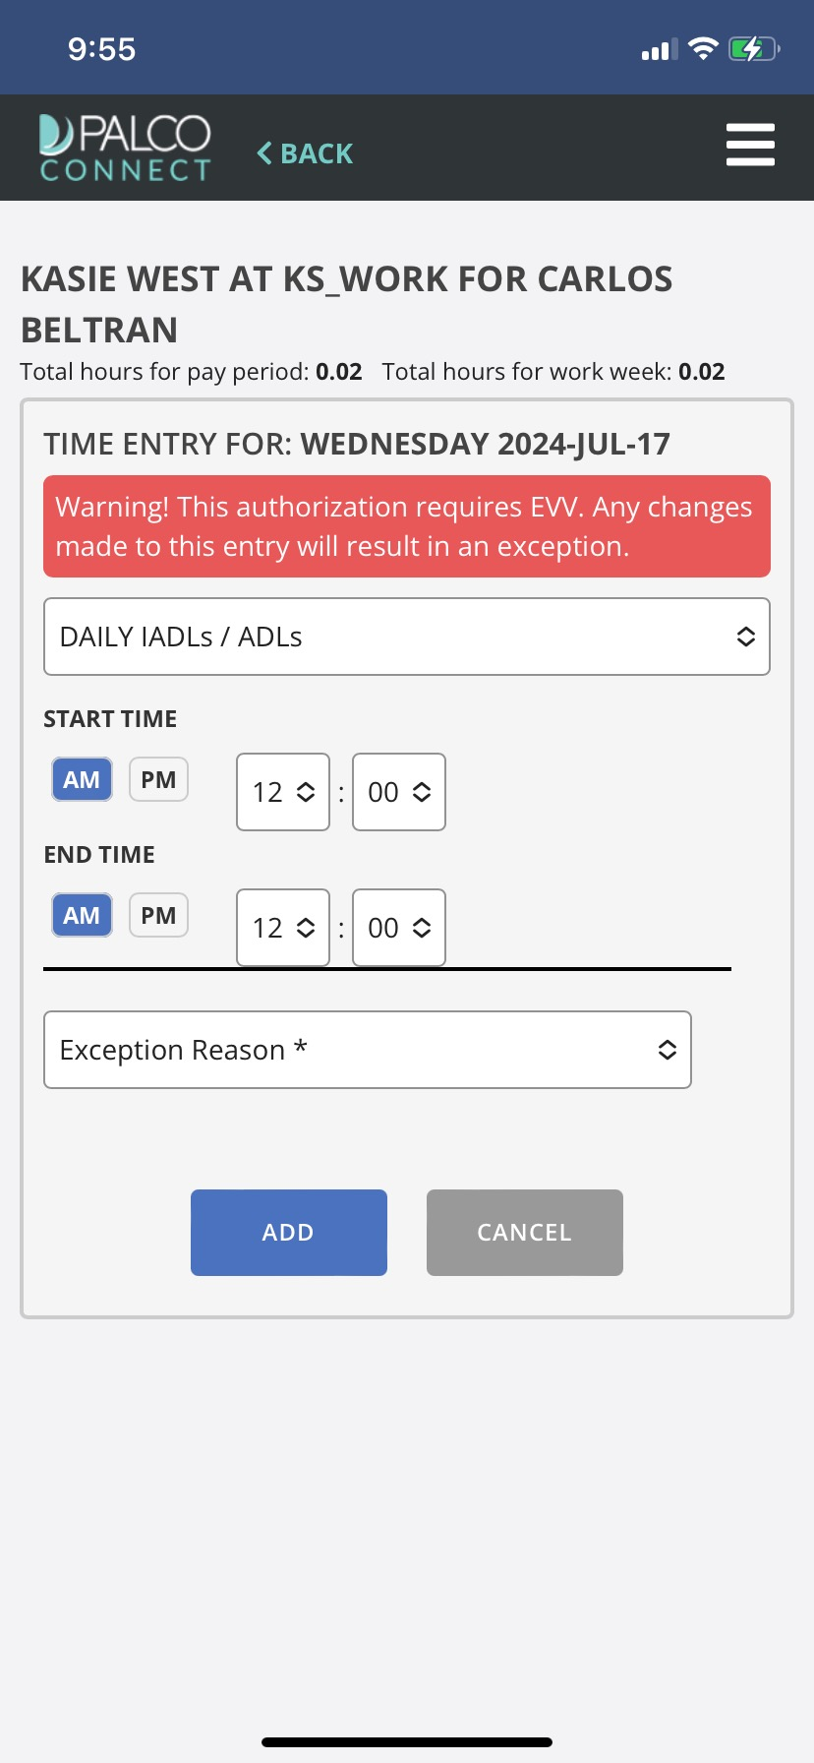
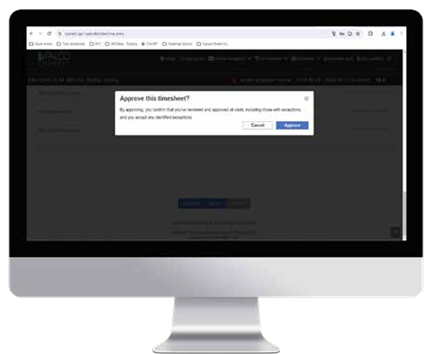
Shift exceptions
Shift exceptions occur when an EVV shift is edited after it has been completed.
WORKERS:
If you need to edit a shift, you will be asked for the exception reason. Please choose the reason that best explains why the entry is being edited.
EMPLOYER:
Please review all time shifts. If a shift has an exception, make sure it is correct. By approving a shift, you are stating that you agree with the date, time, and exception reason being reported by the worker.

Slide 33
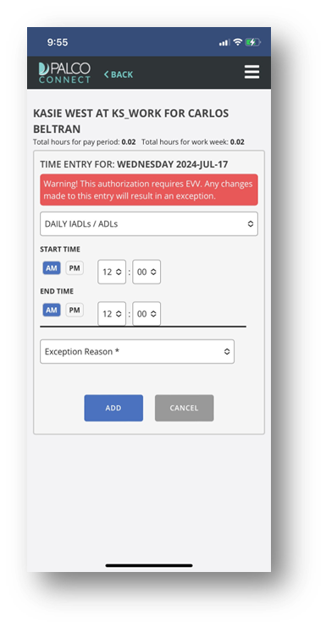
Shift exceptions
I’m a worker. How do I avoid shift exceptions?
Clocking in and out promptly is the easiest way to avoid exceptions. It can also help to double-check all information before selecting Clock In or Clock Out. That way, you do not need to edit a shift later.
I’m the employer. Why do I need to verify the reason for a shift exception?
Part of the role of an employer is to manage the workers. The accuracy of your worker’s time shift reporting can affect your budget. It could also affect your program eligibility. It is very important that the hours submitted for payment are what was worked.

Slide 34

INTERACTIVE VOICE RESPONSE (IVR)

Slide 35
interactive voice response (IVR)
Interactive Voice Response, also known IVR, is another way to report EVV shifts. With IVR, a worker uses the Participant’s touchtone phone to clock in and out. They do this by calling a designated number and responding to the prompts. It is also known as Telephony.
Step 1: To use Interactive Voice Response, call 888-788-8270 using a touchtone phone
Step 2: Use the keypad to enter the worker’s Palco ID, then hit # (the pound key)
Step 3: Enter last 4 of worker’s SSN, then hit # (the pound key)
Step 4: Select the time zone.
Step 5: Enter the participant Palco ID, then hit # (the pound key)
Notes:
Ta -tough

Slide 36

interactive voice response (IVR)
Clocking in/out
Clocking in You will be asked to select a service. Once done, you’ll need to confirm your selection.
Clocking out Key in the appropriate activity code, then press # (the pound key) or skip. You will be asked to confirm your selection.

Slide 37
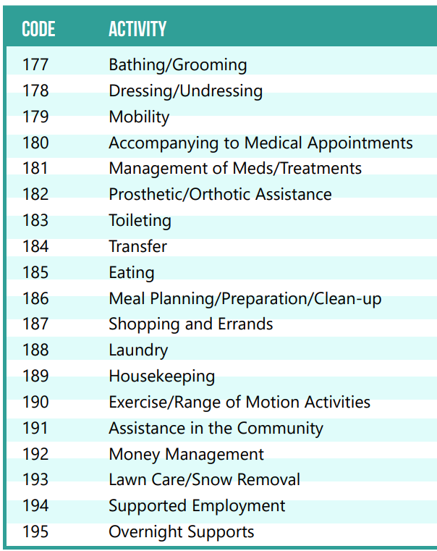
activity codes
Some programs require you to input an activity code. Here is a list of activities with their corresponding codes used with IVR for Kansas WORK.

Slide 38

ADDITIONAL SUPPORT

Slide 39
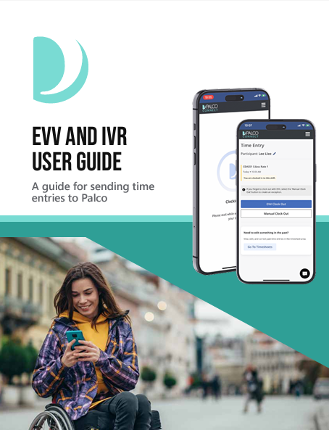

PALCO’S EVV
TRAINING RESOURCES
 User Guide
 Videos
EVV Resources

Slide 40


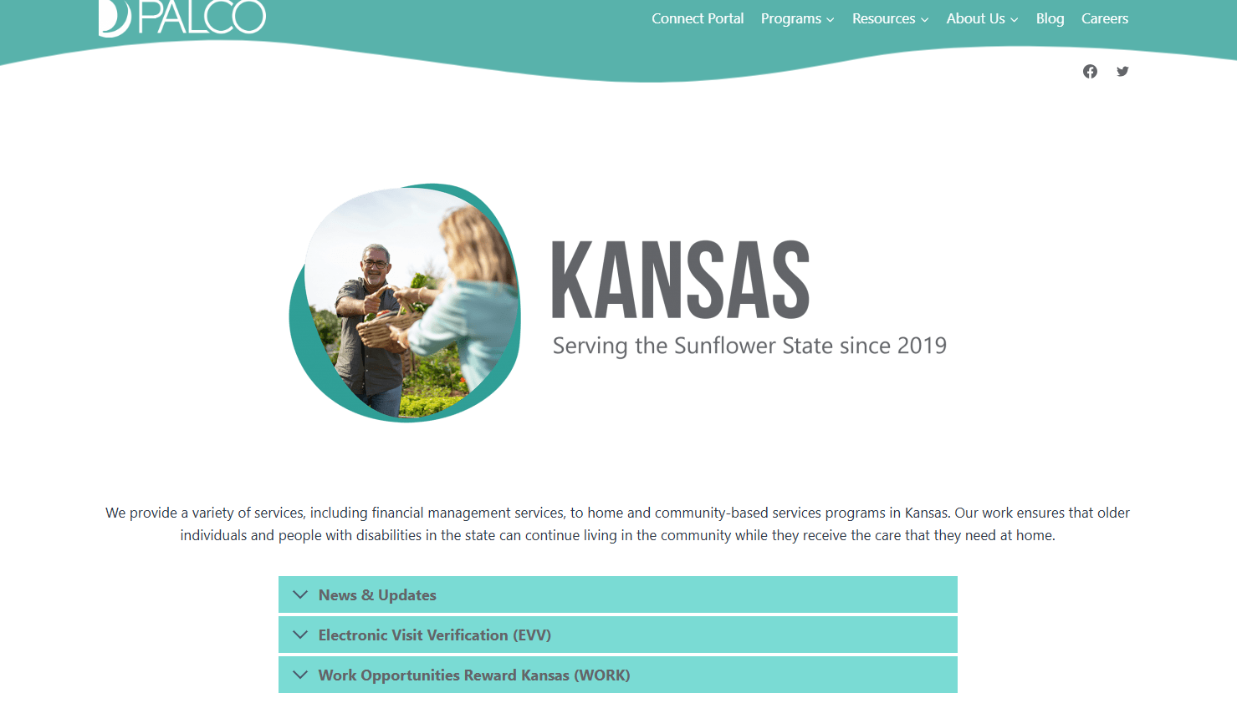
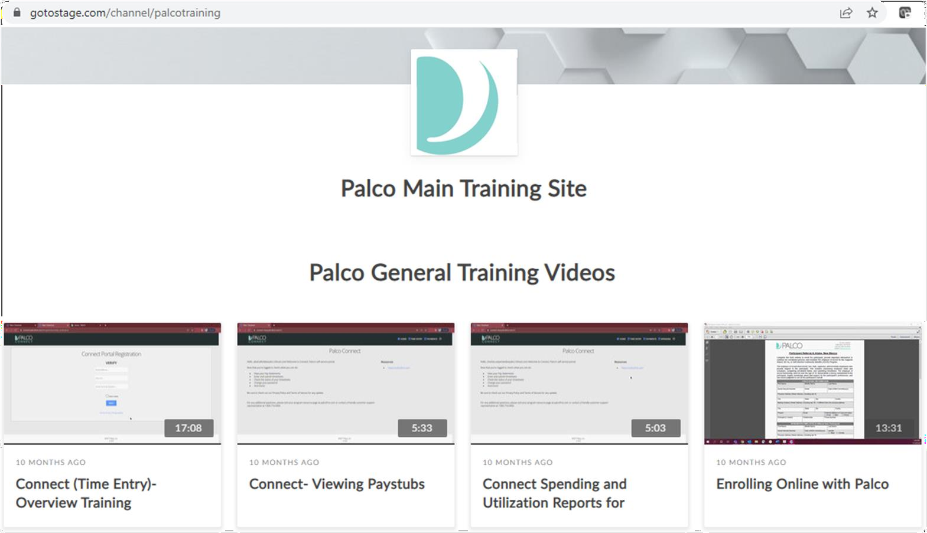
RESOURCES
You can find many helpful resources, training documents, forms, and videos on the Palco website!
https://palcofirst.com/kansas/

Slide 41


Customer Support
You can contact the Palco Customer Support team Monday-Friday between 8:00am and 5:00pm ET.
Phone: 1-866-710-0456 ​
Email: customersupport@palcofirst.com
Visit our website to chat with a live customer service agent!

Slide 42

Questions

Slide 43

Thank you for your time!
For more information about Palco, visit:
https://www.palcofirst.com
​
Email: https://palcofirst.com/
Contact: 1-866-710-0456

